Slide 1
CSC5610 Final Project
By: Tyler Graham, Kirat Mokha, Jessie Bernitt
Date: 12/12/2023

Slide 2
Project Requirements
For the project, you must:
Create a baseline model using the chosen data set with no external data sets, minimal feature engineering, and a linear model.
Apply the following techniques to improve your model:
Feature Engineering: You can try engineering other representations of the features that may give better signals. For example, you could try:
Add More Data: Most gains from model performance come from including additional variables from complementary data sets. You will be required to use two additional data sets to complement the main data set.
One example of a complementary data set would be the American Community Survey from the U.S. Census. The ACS gives median household income, unemployment rates, age distributions, and more by zip code.
You will need to find one or more complementary data sets that you can join with the original to add more variables. Once you acquire, clean, and select the desired columns from the ACS data set, you can join it with your current data set. Other data sets might include population densities, crime rates, or school ratings.
More Complex Model Types: Try other model types such as those based on decision trees / random forests, support vector machines with non-linear kernels (e.g., RBF), and simple feedforward neural networks. Note that you will need to tune the hyper-parameters (e.g., C and epsilon for SV Regression).
Summarize and explain the improvement from the baseline model to your best model. What features, data, and techniques worked best? What insights into the data and techniques did you gain from your efforts?
Create a minimum model for explanatory purposes. You should perform feature selection to identify a model that offers similar prediction performance to your best model but a smaller set of features. Which features are included in this model? Create visualizations to explain the decision rules or boundaries used by this model.
Evaluate the applicability of your model. Is your model performing sufficiently to be trusted and meet the needs of the stakeholders? What insights into the data or problem does your explanatory model provide?

Slide 3
Presentation Requirements
You will create and deliver a 15-minute PowerPoint presentation on your project during finals week. Be generous with visuals. Try to tell an interesting story. Your presentation must include the following:
An overview of the problem and data set you chose. Explain who the stakeholders are and the potential applications / importance. Describe your criteria for success.
A description of your baseline model and its performance
A review of approaches you used to try and achieve your best possible model. What worked? What didn't? What did you learn about the data and the techniques through this process?
A description of your minimal explanatory model.
Key takeaways that are relevant to your colleagues and/or stakeholders.

Slide 4
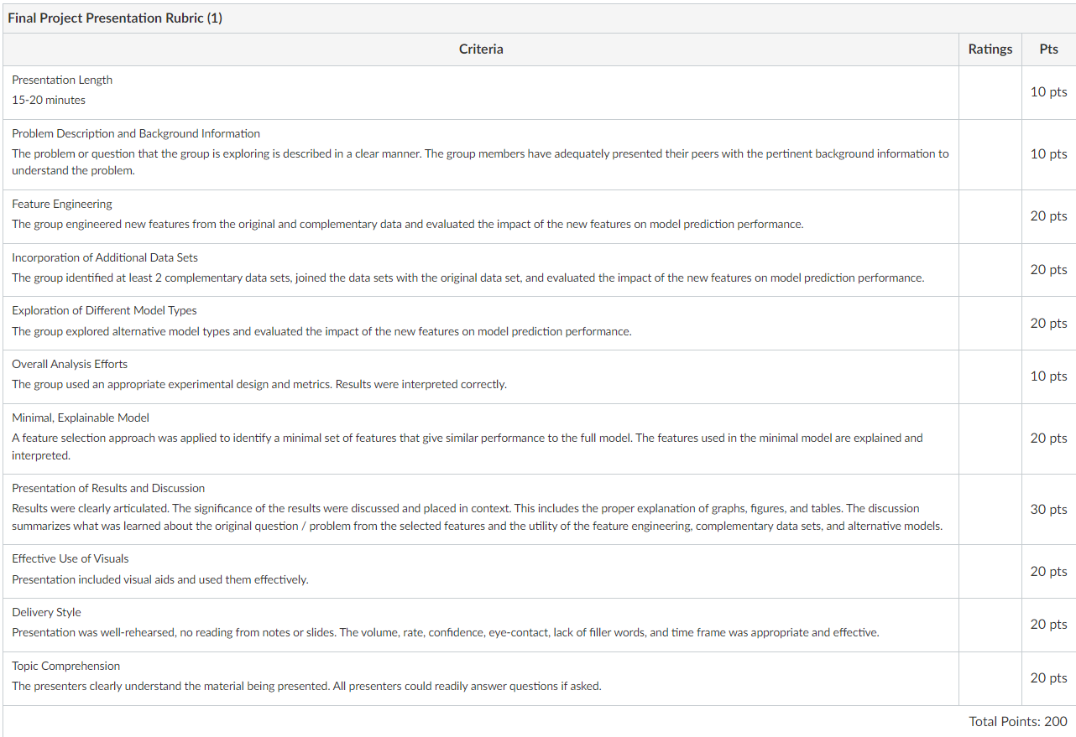

Slide 5
Problem overview and dataset introduction
An overview of the problem and data set you chose. Explain who the stakeholders are and the potential applications / importance. Describe your criteria for success.

Slide 6
Baseline model description and performance
A description of your baseline model and its performance
Create a minimum model for explanatory purposes. You should perform feature selection to identify a model that offers similar prediction performance to your best model but a smaller set of features. Which features are included in this model? Create visualizations to explain the decision rules or boundaries used by this model.

Slide 7
Review of approaches to achieve best model (feature engineering)
A review of approaches you used to try and achieve your best possible model. What worked? What didn't? What did you learn about the data and the techniques through this process?
Feature Engineering: You can try engineering other representations of the features that may give better signals. For example, you could try:

Slide 8
Review of approaches to achieve best model (alternative datasets)
A review of approaches you used to try and achieve your best possible model. What worked? What didn't? What did you learn about the data and the techniques through this process?
Add More Data: Most gains from model performance come from including additional variables from complementary data sets. You will be required to use two additional data sets to complement the main data set.
One example of a complementary data set would be the American Community Survey from the U.S. Census. The ACS gives median household income, unemployment rates, age distributions, and more by zip code.
You will need to find one or more complementary data sets that you can join with the original to add more variables. Once you acquire, clean, and select the desired columns from the ACS data set, you can join it with your current data set. Other data sets might include population densities, crime rates, or school ratings.

Slide 9
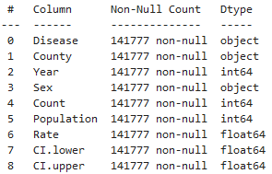
Alternative Dataset - Rates of Infectious Diseases
Dataset with similar diseases as original that includes rate of infection
Data cleaning approach:
Find similar diseases and name in consistent manner with original dataset
Drop any diseases that don’t match
Find mean of disease rate
Data spans multiple counties and genders. Parse down to one overall rate.
Decision Tree Results
Overall, this data slightly decreased our model performance (97.2% -> 97%)
Possible improvements would be to use more of the features from this alternate dataset.
Difficult due to limited features in original dataset to correlate with (i.e. sex, population, location, etc.)

Slide 10
Alternative Dataset – Symptom Severity
Dataset includes a severity rating for various symptoms
Data cleaning was minimal and just involved formatting text in same format as original dataset and correcting one spelling error
Model performance was the same as the original model (97.2%)
Suggests that this data doesn’t really add much to the original data
Tried increasing multiple of the severity ranking and did not have any effect

Slide 11
Alternative Dataset – Disease Rate and Symptom Severity
Approach was to take the two alternative dataset and integrate both of them into the original dataset
Data cleaning process was the same as the two previous attempts
Model performance was the same as using the disease rate alternative dataset by itself (97.2% -> 97%)
Again it seems that symptom severity has no effect on model performance

Slide 12
Alternative Dataset – Test Model on Two Other Datasets
Approach was to take two different datasets that included similar symptoms and diseases and run them through the original model to see how accurate it was on new data
Data cleaning was very intensive as many symptoms were present in the original dataset but not in the alternates
Many symptoms and diseases had different wording (i.e. chickenpox is the same as varicella)
Also involved interpreting some symptoms and diseases that at time was obvious but at others could be incorrect
Dengue fever and dengue are probably a match
Fever and mild fever may or may not be the same symptom
Model performance decreased significantly (97.2% -> 11.8%)

Slide 13
Alternative Dataset – Test Model on Two Other Datasets (cont.)
Took a second dataset with diseases and symptoms
Data cleaning approach was the same and matching names for diseases and symptoms was sometimes obvious and other times not
Model performance on this dataset was even worse than the first alternate dataset
Original dataset: 97.2%
Alternate 1 dataset: 11.8%
Alternate 2 dataset: 6.5%

Slide 14
Alternative Dataset – Create Model on Alternate Data and Test Original Dataset)
Used alternate 1 dataset to train a model and tested on the original dataset
Known limitations on alternate 1 due to it only including one instance of every disease
Data cleaning approach was the same as previous
Model performance when tested on original dataset was 18.9%

Slide 15
Alternative Dataset – Conclusion
Consistency in data is key
Symptom and disease names need to match if at all possible
Data collection needs to consider how to collect data in such a way that there is little room for error and minor interpretation needed
Things to consider:
How many symptoms do we want to record for a disease?
What level of symptoms do we want (i.e. mild fever vs fever)?
What name do we want for diseases (i.e. chicken pox vs. varicell)?
Some of this comes down to the system collecting the data as well as the users entering the data
Many places along the way for things to go wrong from the entry phase to interpretation of the data
Also need to consider if more data could be better
In original dataset:
What region of the world was the data collected?
What was the age, gender, etc. of those diagnosed with these diseases?

Slide 16
Review of approaches to achieve best model (alternative models)
A review of approaches you used to try and achieve your best possible model. What worked? What didn't? What did you learn about the data and the techniques through this process?
More Complex Model Types: Try other model types such as those based on decision trees / random forests, support vector machines with non-linear kernels (e.g., RBF), and simple feedforward neural networks. Note that you will need to tune the hyper-parameters (e.g., C and epsilon for SV Regression).

Slide 17
Description of minimal explanatory model
A description of your minimal explanatory model.
Summarize and explain the improvement from the baseline model to your best model. What features, data, and techniques worked best? What insights into the data and techniques did you gain from your efforts?

Slide 18
Key takeaways
Key takeaways that are relevant to your colleagues and/or stakeholders.
Evaluate the applicability of your model. Is your model performing sufficiently to be trusted and meet the needs of the stakeholders? What insights into the data or problem does your explanatory model provide?

Slide 19
Sources
Original Dataset: Link
Alternate 1 Dataset: Link
Alternate 2 Dataset: Link
Disease Rates: Link
Symptom Severity: Link

